Slide 1

Ethics for the Information Age
Eighth Edition
Chapter 1
Catalysts for Change
Copyright © 2020, 2017, 2015 Pearson Education, Inc. All Rights Reserved
Notes:
If this PowerPoint presentation contains mathematical equations, you may need to check that your computer has the following installed:
1) MathType Plugin
2) Math Player (free versions available)
3) NVDA Reader (free versions available)

Slide 2
Learning Objectives
1.1 Introduction
1.2 Milestones in computing
1.3 Milestones in networking
1.4 Milestones in information storage and retrieval
1.5 Information technology issues

Slide 3
1.1 Introduction

Slide 4
Information Age
Unprecedented access to information in modern era
Catalysts
Low-cost computers
High-speed communication networks
New technologies continue to emerge
Smartphones
Video streaming services
Voice-activated digital assistants
Low-cost drones
Self-driving cars

Slide 5
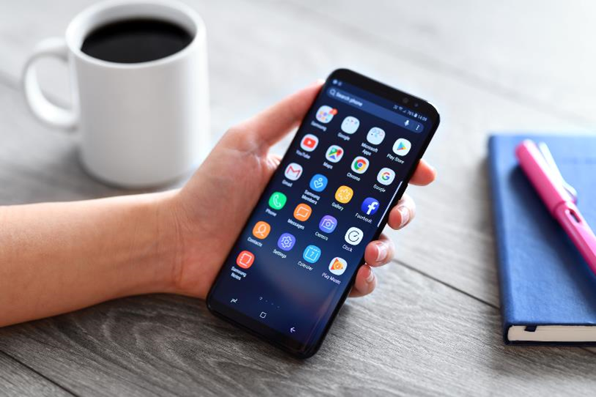
Figure 1-1: Samsung Galaxy S9 Plus
Low-cost computers and high-speed communication networks make possible the products of the Information Age, such as the Samsung Galaxy S9 Plus. It functions as a phone, text messager, email client, Web browser, camera, video recorder, digital compass, and much more.

Slide 6
Impact of Modern Computing and Communications Systems
World in 1950
Only a handful of electronic digital computers
Internet did not exist
Contemporary world
Networked devices containing embedded microprocessors surround us
We engage with these devices for hours each day

Slide 7
Our Relationship with Technology (1 of 2)
Dynamic between people, technology
People create, adopt technology
Once adopted, technology changes society
Using technology can change people
Experiences cause physical changes in brains (e.g., London taxi drivers)
Getting information releases dopamine in brain, producing a desire to seek out additional information
Experiences with technology can have psychological effects, too (e.g., dependency on cell phones)

Slide 8
Our Relationship with Technology (2 of 2)
Technologies solve problems, but may create new problems
Automobiles
Greater mobility
Traffic jams
Web
Supports valuable information retrieval tools
Children may be exposed to inappropriate content
Low-cost international communication
Global access to news, entertainment
Jobs outsourced to less expensive labor markets

Slide 9
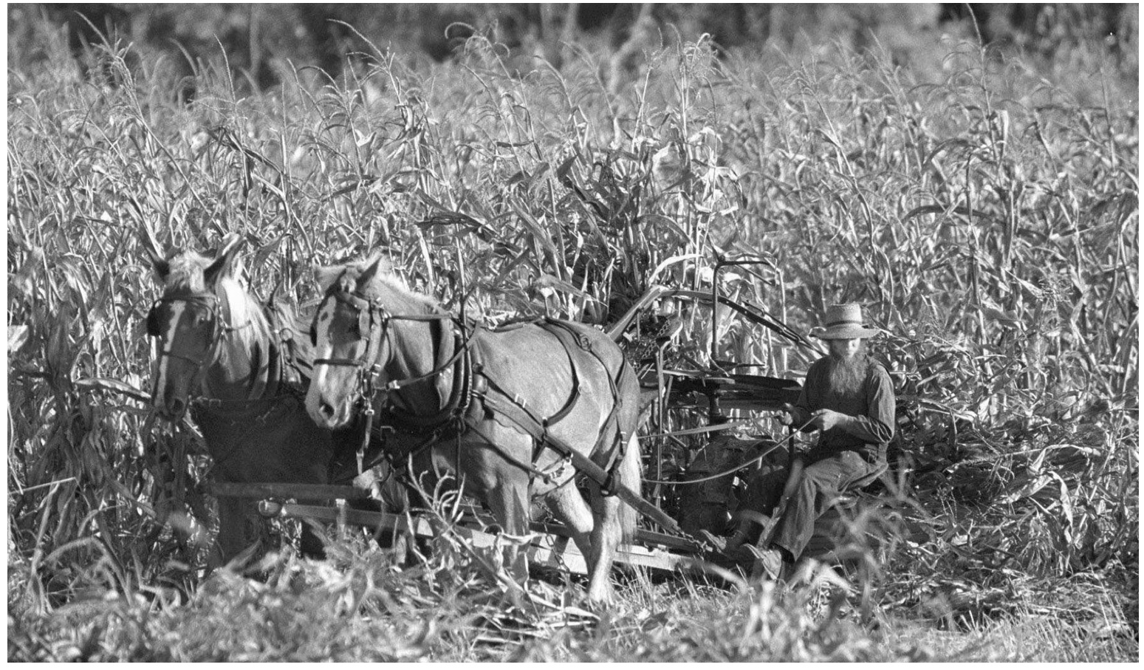
Amish Selectively Adopt New Technologies
A P Photos/The Indianapolis Star and News, Mike Fender

Slide 10
Theme of Chapter 1: Social-Technological Cycle
Social conditions can lead to creation and adoption of new information technologies
Adopting new information technologies can change social conditions

Slide 11
1.2 Milestones in Computing

Slide 12
Aids to Manual Calculating (1 of 2)
Tablet to record numbers
Clay, wax tablets (ancient times)
Slates (late Middle Ages)
Paper tablets (19th century to present)
Abacus to perform arithmetic
Rods or wires in rectangular frame
Lines drawn on a counting board

Slide 13
Aids to Manual Calculating (2 of 2)
Mathematical tables
Tables of logarithms (17th century)
Income tax tables (today)

Slide 14
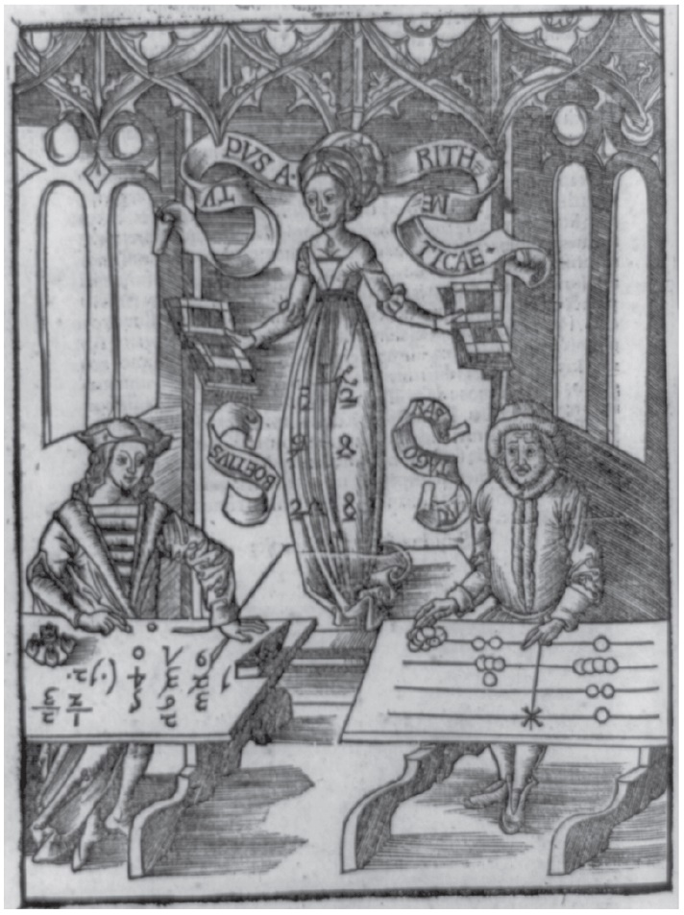
Slate and Counting Board
(Library of Congress Prints and Photographs Division ]L C-U S Z62-95297])

Slide 15
Early Mechanical Calculators (1 of 2)
Calculators of Pascal and Leibniz (17th century)
Worked with whole numbers
Unreliable
Arithmometer of de Colmar (19th century)
Took advantage of advances in machine tools
Adopted by insurance companies

Slide 16
Early Mechanical Calculators (2 of 2)
Printing calculator of Scheutzes (19th century)
Used method of differences pioneered by Babbage
Adopted by Dudley Observatory in New York
Completed astronomical calculations

Slide 17
Social Change → Market for Calculators
Gilded Age (late 19th century America)
Rapid industrialization
Economic expansion
Concentration of corporate power
New, larger corporations
Multiple layers of management
Multiple locations
Needed up-to-date, comprehensive, reliable, and affordable information

Slide 18
Calculator Adoptions → Social Change
Fierce market
Continuous improvements in size, speed, ease of use
Sales increased rapidly
“Deskilling” and feminization of bookkeeping
People of average ability quite productive
Calculators 6× faster than adding by hand
Wages dropped
Women replaced men

Slide 19
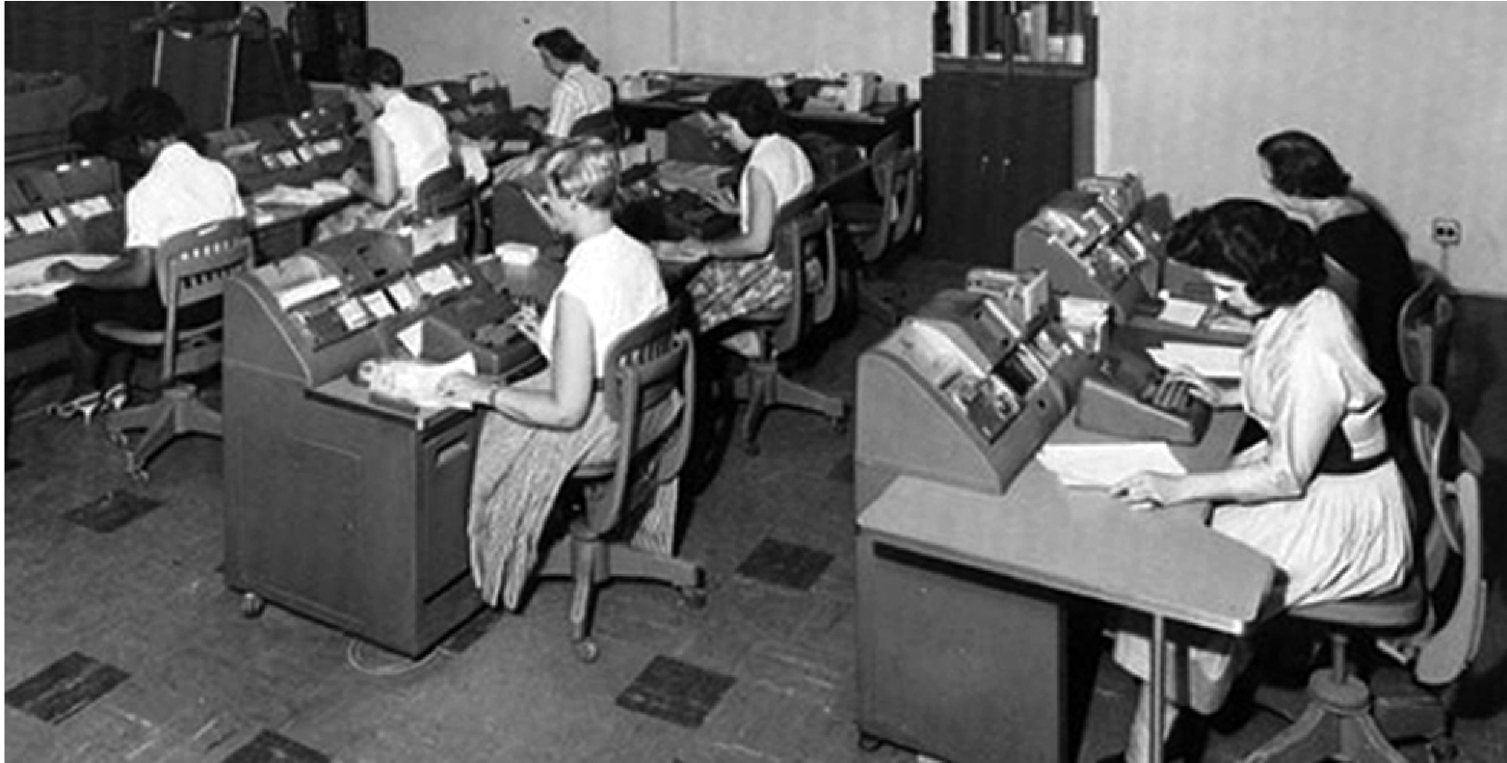
Figure 1-4: Feminization of Bookkeeping
Mechanical calculators led to the “de-skilling” and “feminization” of bookkeeping. (Automatic Data Processing (A D P))

Slide 20
Cash Register (1 of 2)
In late 1800s smaller stores evolved into “department stores” with multiple departments
Two problems faced by department store owners
Keeping accurate sales records
Preventing embezzlement from clerks
Response to problems: cash register
Created printed, itemized receipts
Maintained printed log of transactions
Rang bell every time drawer was opened

Slide 21
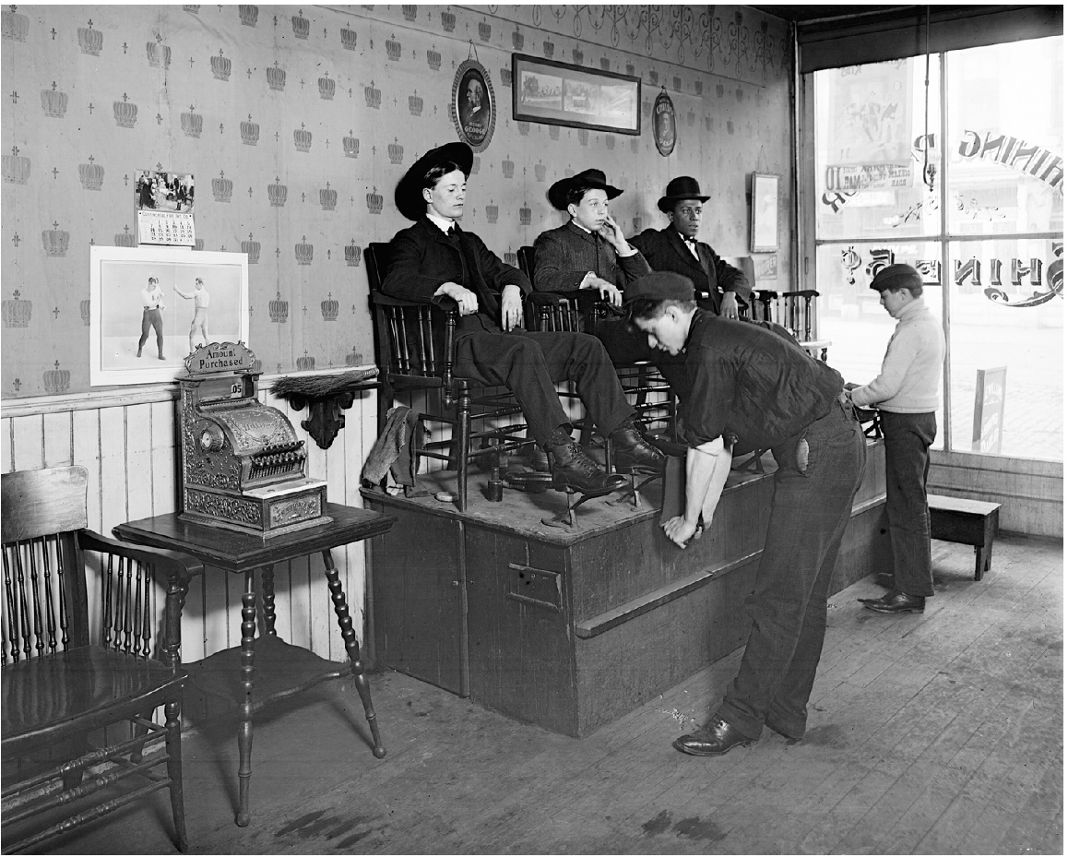
Cash Register (2 of 2)
An N C R cash register in Miller’s Shoe Shine Parlor, Dayton, Ohio (1904). (The N C R Archive at Dayton History)

Slide 22
Punched Card Tabulation
Punched cards (late 19th century)
One record per card
Cards could be sorted into groups, allowing computation of subtotals by categories
Early adopters
U.S. Bureau of the Census
Railroads
Retail organizations
Heavy industries

Slide 23
Tabulators → Data-Processing Systems
Data-processing system
Receives input data
Performs one or more calculations
Produces output data
Punched cards
Stored input data and intermediate results
Stored output
On most sophisticated systems, also stored programs

Slide 24
I B M and the Holocaust
Hitler came to power in Germany in 1933
I B M C E O Watson ignored anti-Semitic violence, creation of concentration camps
I B M expanded German subsidiary and sought contracts with German government
Nazis used I B M machines to conduct censuses, generate lists of Jews
Lists facilitated seizure of assets and deportation to concentration camps

Slide 25
Precursors of Commercial Computers
Atanasoff-Berry Computer: vacuum tubes
E N I A C: externally programmed with wires
E D V A C: program stored in memory
Small-Scale Experimental Machine: C R T memory

Slide 26
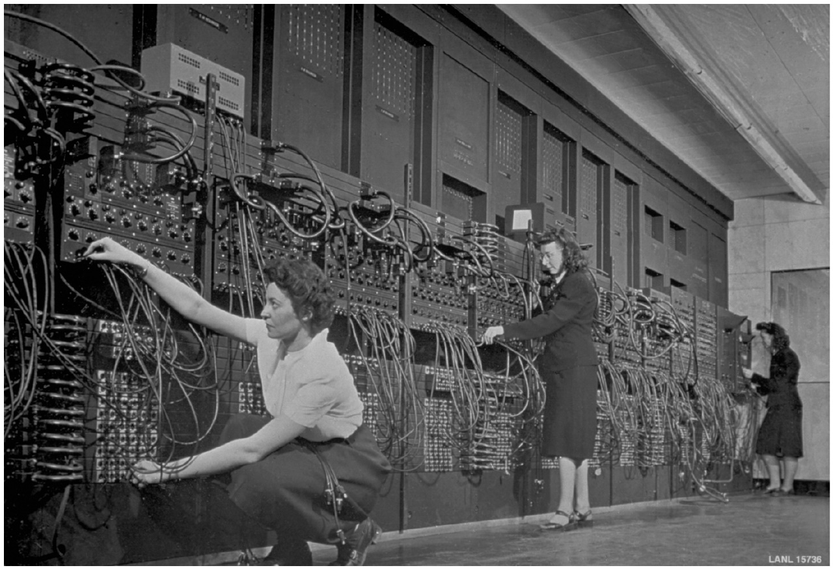
Programming the E N I A C
The E N I A C ’s first six programmers were women. Every instruction was programmed by connecting several wires into plugboards. (Corbis Historical/Getty Images)

Slide 27
First Commercial Computers
Remington-Rand
Completed U N I V A C in 1951
Delivered to U.S. Bureau of the Census
Predicted winner of 1952 Presidential election
I B M
Larger base of customers
Far superior sales and marketing organization
Greater investment in research and development
Dominated mainframe market by mid-1960s

Slide 28
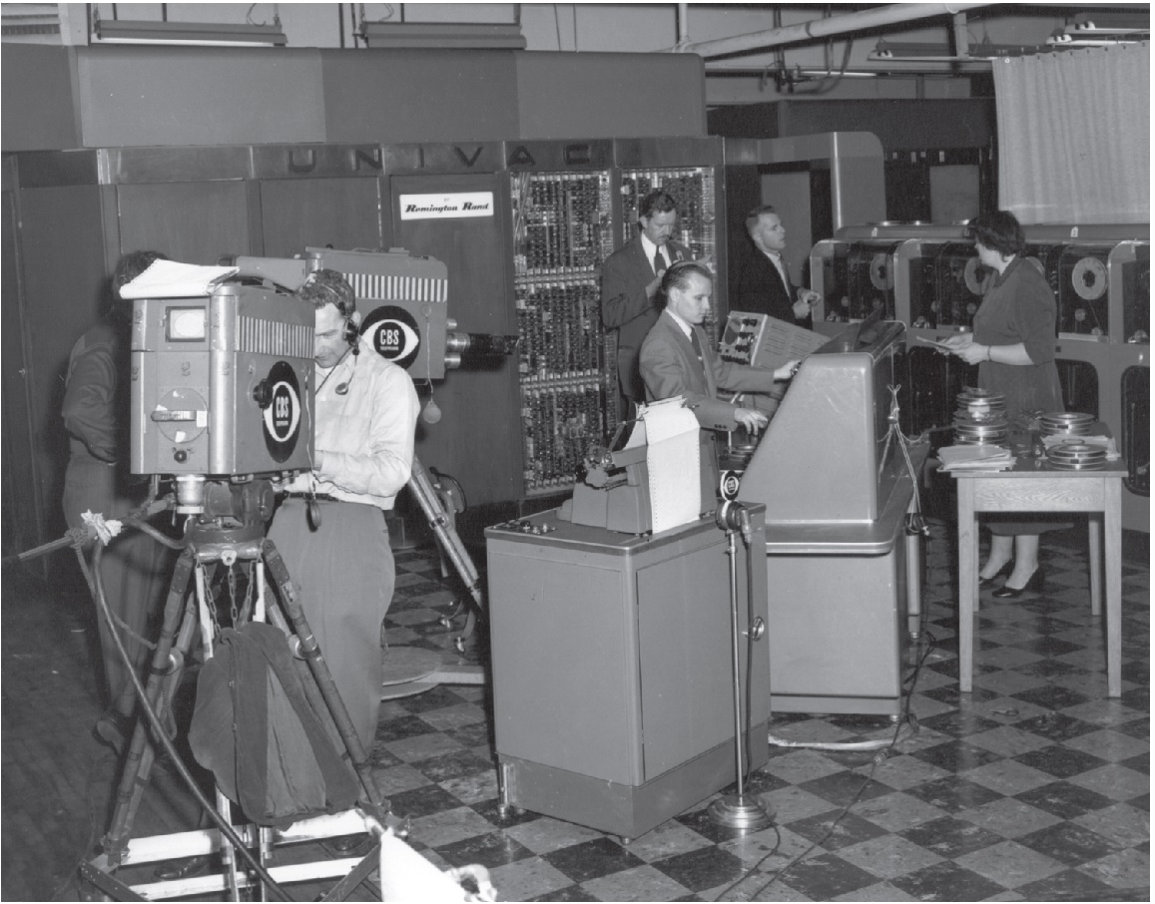
C B S News Coverage of 1952 Presidential Election Featured U N I V A C Computer
C B S news coverage of the 1952 presidential election included predictions made by a U N I V A C computer. When the computer predicted Eisenhower would win in a landslide, consternation followed. (Photo reproduced courtesy of Unisys Corporation)

Slide 29
Programming Languages
Assembly language
Symbolic representations of machine instructions
Programs just as long as machine language programs
FORTRAN
First higher-level language (shorter programs)
Designed for scientific applications
COBOL
U.S. Department of Defense standard
Designed for business applications

Slide 30
Time-Sharing Systems and BASIC
Time-Sharing Systems
Divide computer time among multiple users
Users connect to computer via terminals
Cost of ownership spread among more people
Gave many more people access to computers
BASIC
Developed at Dartmouth College
Simple, easy-to-learn programming language
Popular language for teaching programming

Slide 31
Transistor
Replacement for vacuum tube
Invented at Bell Labs (1948)
Semiconductor
Faster
Cheaper
More reliable
More energy efficient

Slide 32
Integrated Circuit
Semiconductor containing transistors, capacitors, and resistors
Invented at Fairchild Semiconductor and Texas Instruments
Advantages over parts they replaced
Smaller
Faster
More reliable
Less expensive

Slide 33
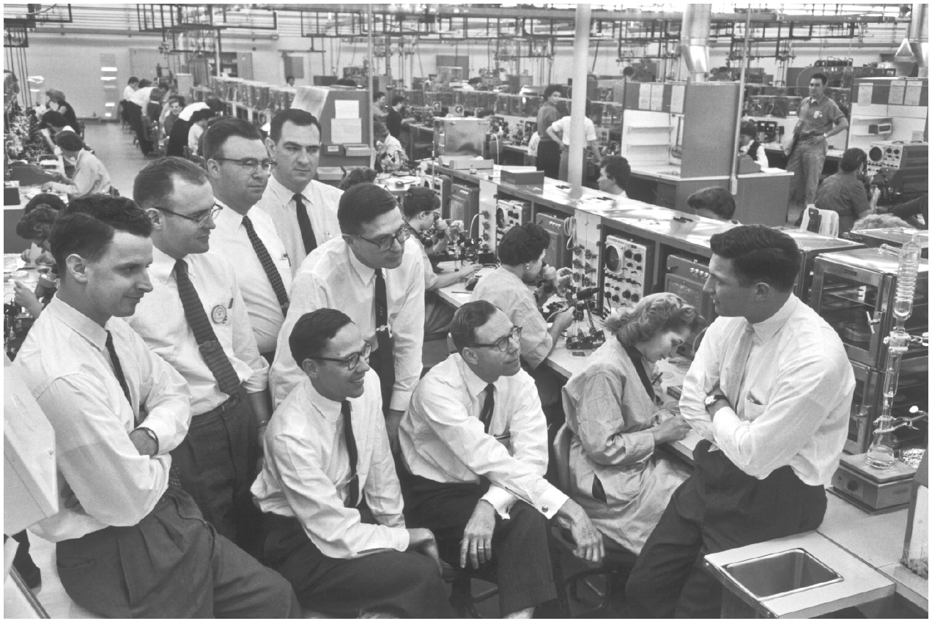
Fairchild Semiconductor Founders
The eight founders of Fairchild Semiconductor on the factory floor. Gordon Moore is second from the left and Robert Noyce is on the right. (Wayne Miller/Magnum Photos, Inc.)

Slide 34
I B M System/360 (1 of 2)
Before System/360
I B M dominated mainframe marked in 1960s
I B M computers were incompatible
Switch computers → rewrite programs
System/360
Series of 19 computers with varying levels of power
All computers could run same programs
Upgrade without rewriting programs

Slide 35
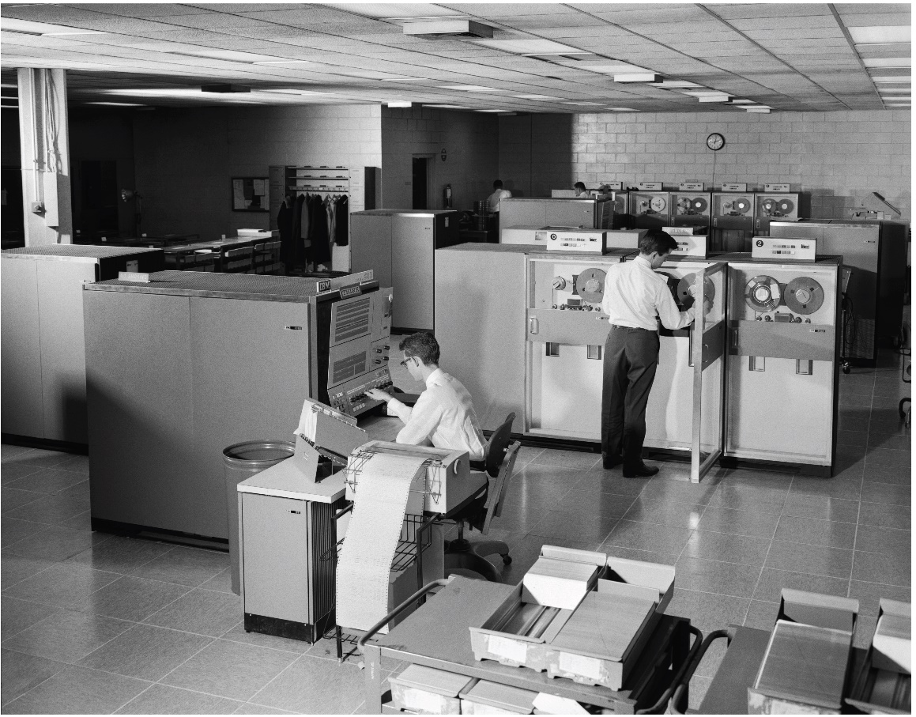
I B M System/360 (2 of 2)
In the 1960s, I B M dominated the mainframe computer market in the United States. (H. Armstrong Roberts/Classic Stock/Alamy)

Slide 36
Microprocessor
Computer inside a semiconductor chip
Invented in 1970 at Intel
Made personal computers practical

Slide 37
Antecedents to the Personal Computer (1 of 2)
Whole Earth Catalog
“Sort of like Google in paperback form” (Steve Jobs)
Stewart Brand saw “technology as a tool for individual and collective transformation” (Fred Turner)
People’s Computer Company
Educated people on how to use computers
People gathered around time-share computers
Culture promoted free exchange of software

Slide 38
Antecedents to the Personal Computer (2 of 2)
Homebrew Computer Club
Meeting place for hobbyists
Steve Wozniak created system that became Apple I

Slide 39
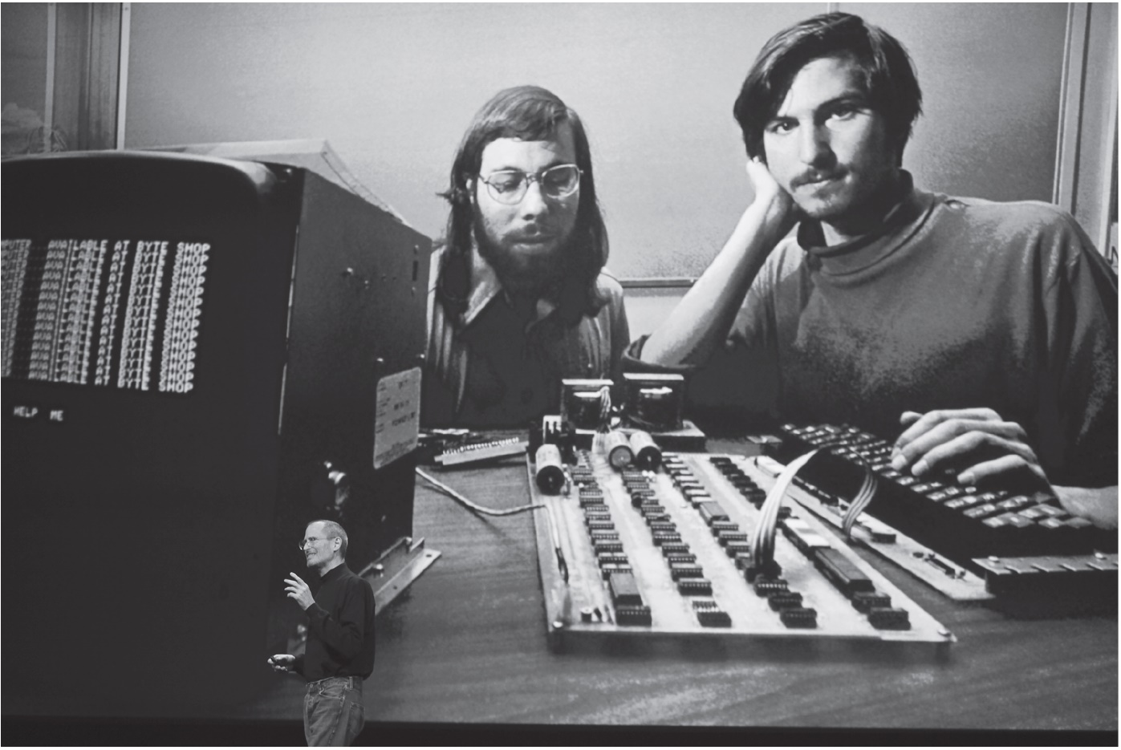
Steve Wozniak and Steve Jobs With Apple 1e Personal Computer
Steve Jobs (right) convinced Steve Wozniak (left) they should go into business selling the personal computer Wozniak designed. They named their company Apple Computer. (Kimberly White/Reuters)

Slide 40
Personal Computer (1 of 2)
Altair 8800
Gates and Allen created BASIC interpreter
Interpreter pirated at Homebrew Computer Club meeting
Personal computers became popular
Apple Computer: Apple
Tandy Corporation: T R S 80

Slide 41
Personal Computer (2 of 2)
Businesses drawn to personal computers
Computer spreadsheet program: VisiCalc
I B M launches I B M P C

Slide 42
1.3 Milestones in Networking

Slide 43
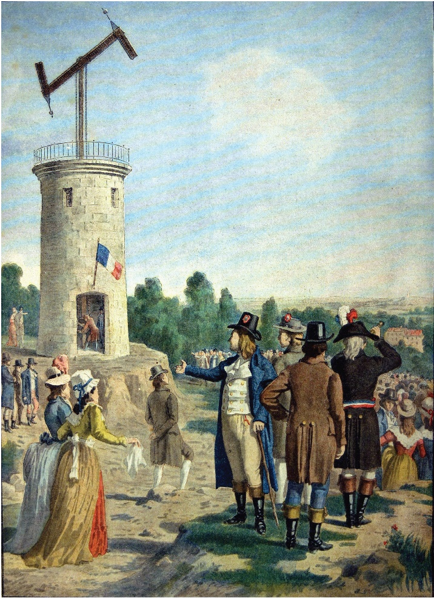
Early Networking: Semaphore Telegraph Tower
A semaphore telegraph tower on the first line from Paris to Lille (1794). (Interfoto/Alamy)

Slide 44
Electricity and Electromagnetism
Volta invented battery (1799)
Oersted: electricity creates magnetic field
Sturgeon constructed electromagnet
Henry: communication using electromagnets (1830)

Slide 45
Telegraph (1 of 2)
U.S. government funded first line
40 miles from Washington, D.C. to Baltimore
Built by Samuel Morse in 1843-1844
Private networks flourished
12,000 miles of lines in 1850
Transcontinental line in 1861 put Pony Express out of business
200,000 miles of lines by 1877

Slide 46
Telegraph (2 of 2)
Technology proved versatile
Fire alarm boxes
Police call boxes

Slide 47
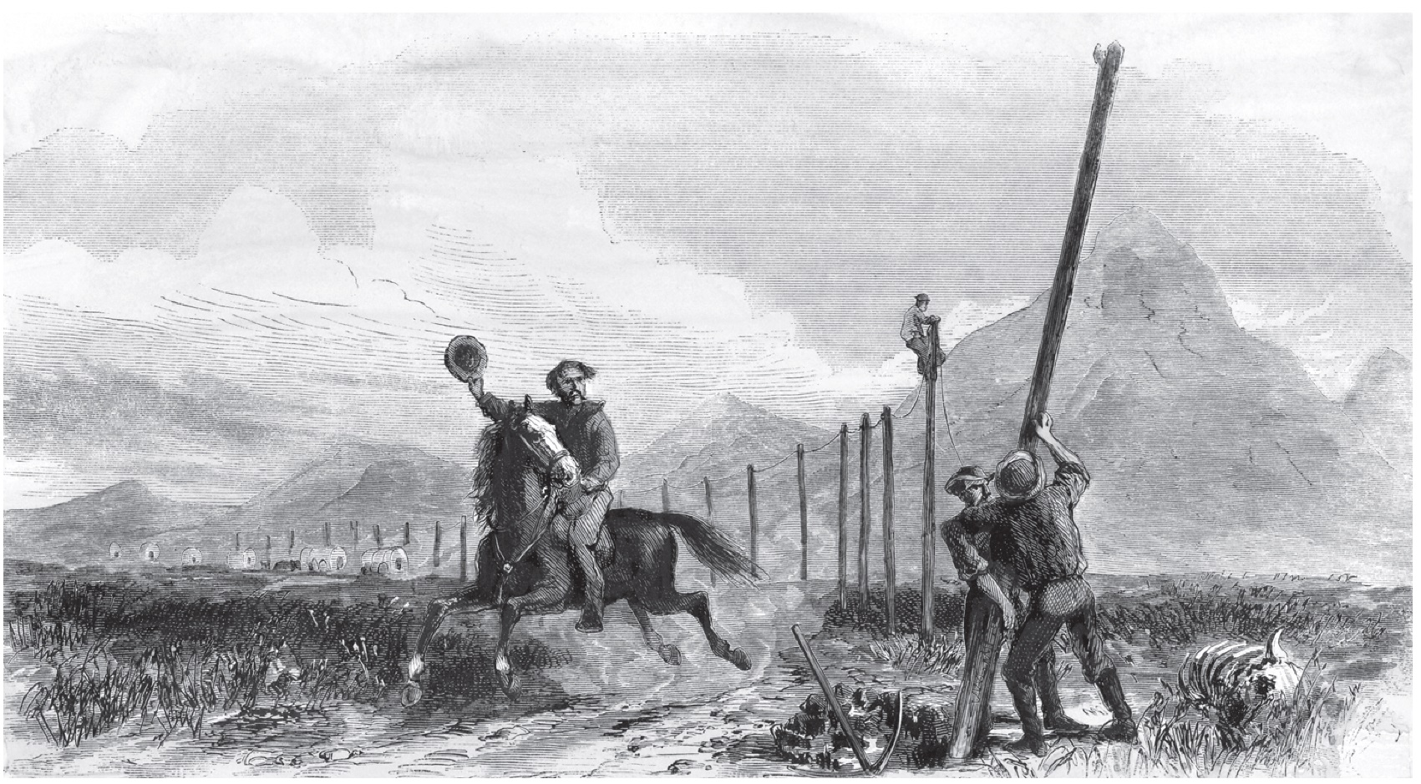
Impact of Telegraph
Pony Express riders lost their jobs when the U S transcontinental telegraph line was completed in 1861. (North Wind Picture Archives / Alamy)

Slide 48
Telephone
Alexander Graham Bell
Constructed harmonic telegraph
Leveraged concept into first telephone
Social impact of telephone
Blurred public life / private life boundary
Eroded traditional social hierarchies
Reduced privacy
Enabled first “online” communities

Slide 49
Typewriter and Teletype
Typewriter
Individual production of “type set” documents
Common in offices by 1890s
Teletype
Typewriter connected to telegraph line
Popular uses
Transmitting news stories
Sending records of stock transactions

Slide 50
Radio
Pioneers
Hertz generated electromagnetic waves
Marconi invented radio
First used in business
Wireless telegraph
Transmit voices
Entertainment uses
Suggested by Sarnoff
Important entertainment medium by 1930s

Slide 51
Television
Became popular in 1950s
Price fell dramatically
Number of stations increased
Social effects
Worldwide audiences
Networks strive to be first to deliver news
Impact of incorrect information; e.g., 2000 presidential election

Slide 52
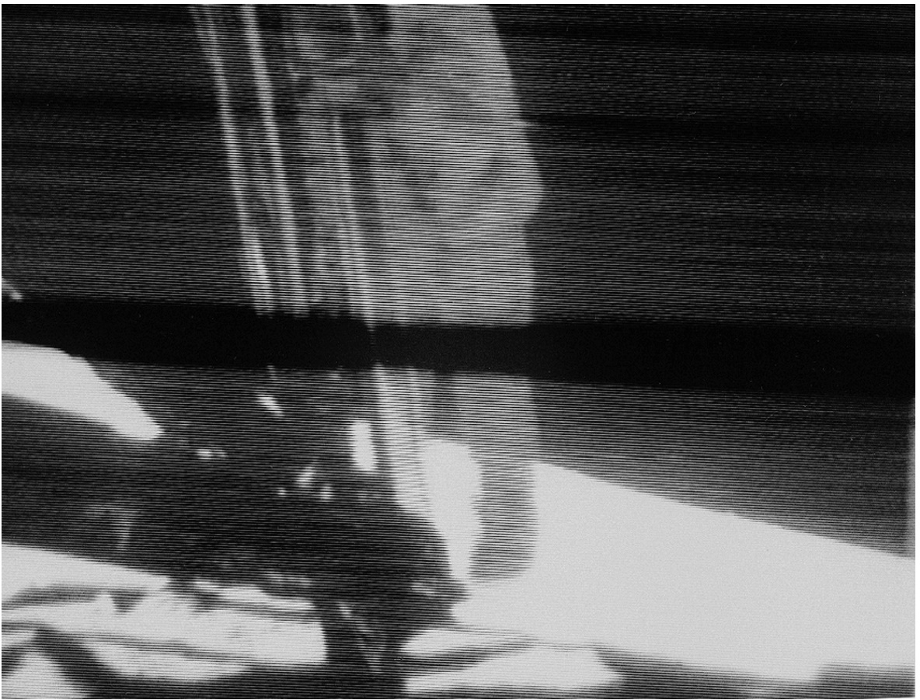
Hundreds of Millions Watch Moon Landing in 1969
On July 20, 1969, television images of Neil Armstrong walking on the Moon were broadcast to hundreds of millions of viewers around the world. (Courtesy of NASA)

Slide 53
Remote Computing
Stibitz and Williams built Complex Number Calculator at Bell Labs
Bell Labs part of A T&T (phone company)
Teletype chosen for input/output
Allowed operator to be distant from machine
Long-distance demonstration between New Hampshire and New York City

Slide 54
ARPANET
D o D created A R P A in late 1950s
Licklider conceived of “Galactic Network”
Decentralized design to improve survivability
Packet-switching replaced circuit switching

Slide 55
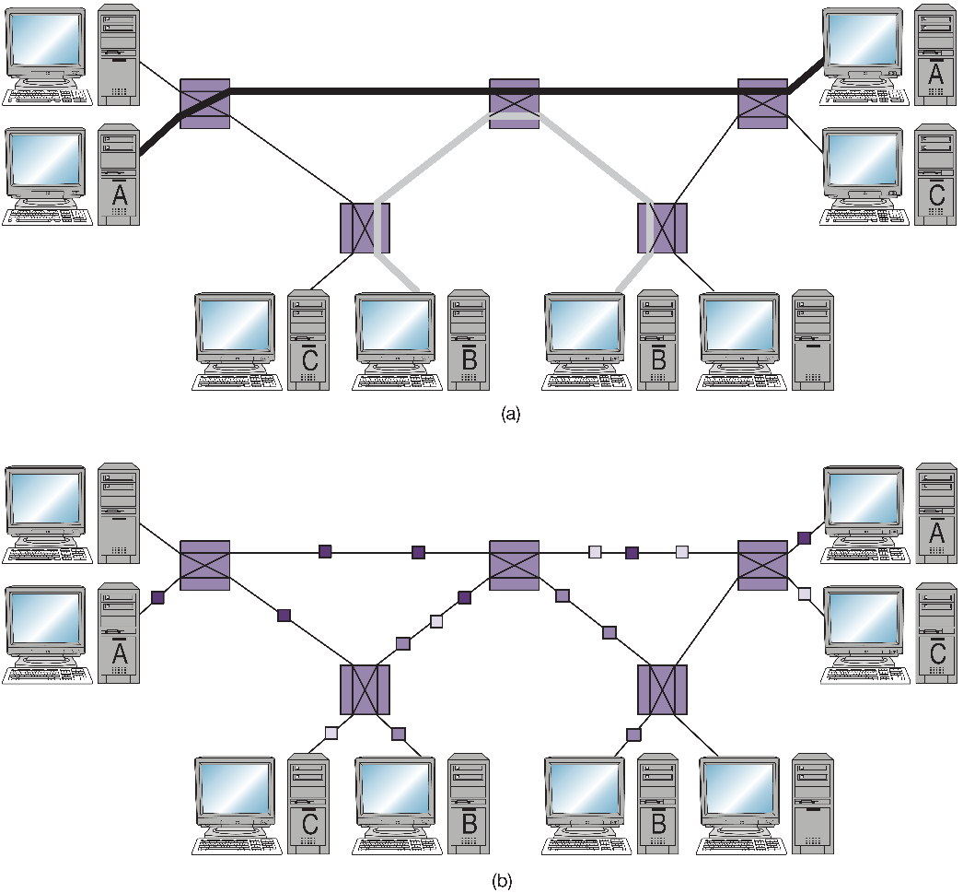
Circuit-Switched versus Packet-Switched Networks
Comparison of circuit-switched networking (a) and packet-switched networking (b).

Slide 56
Email
Creation
Tomlinson at B B N wrote software to send, receive email messages
Roberts created email utility
Current status
One of world’s most important communication technologies
Billions of messages sent in U.S. every day

Slide 57
Internet
Kahn conceived of open architecture networking
Cerf and Kahn designed T C P/I P protocol
Internet: network of networks communicating using T C P/I P

Slide 58
N S F NET
Created by National Science Foundation
Provided access grants to universities
Encouraged commercial subscribers for regional networks
Banned commercial traffic on N S F NET Backbone
Private companies developed long-distance Internet connections
After private networks established, N S F shut down N S F NET Backbone

Slide 59
Broadband
Broadband
High-speed Internet connection
Makes feasible transfer of very large files (e.g., video)
Growth in file-swapping growth parallels growth in broadband
Typical broadband speeds
South Korea (#1): 28.6 megabits/second
Norway (#2): 23.5 megabits/second
Sweden (#3): 22.5 megabits/second
United States (#10): 18.7 megabits/second

Slide 60
Wireless Networks
Cell phones
Appeared in 1973, weighed 2 ½ pounds
Now weigh a few ounces and also support texting and broadband Internet access
Public access wireless local area networks
Proposed in 1993
Hotspot: wireless Internet access point
Wi-Fi most common hotspot technology

Slide 61
Cloud Computing (1 of 2)
Cloud computing: utilization of remote computing resources over Internet
Enablers of cloud computing
High-speed networks
High-performance, low-cost microprocessors
Virtualization: software allowing a single physical computer to emulate many virtual computing devices
Advantages of cloud computing
Massive data centers have an economy of scale
Users gain flexible use of computing resources

Slide 62
Cloud Computing (2 of 2)
Software as a service
Use of remote computing resources to deliver applications to user
Microsoft Office 365, for example
Infrastructure as a service
Use of remove storage and computational resources on a pay-as-you-go basis
Examples: Amazon Web Services, Microsoft Azure, Google Cloud Platform, I B M Cloud

Slide 63
1.4 Milestones in Information Storage and Retrieval

Slide 64
Greek Alphabet
True alphabet: letters for both consonant and vowel sounds
750 B C: Greeks developed first true alphabet with 24 characters
Simple, efficient way of transforming spoken words into written form
Oral culture transitioned to written culture

Slide 65
Codex and Paper
Codex
Rectangular pages sewn together on one side
Replaced papyrus scrolls as way of storing books
Allowed quicker access to particular passages
First produced by hand, then by wood engraving
Paper
Invented by Chinese, brought to Europe in late Middle Ages
By 15th century replaced parchment for pages in less expensive codices

Slide 66
Gutenberg’s Printing Press
Based on movable metal type
Church principal customer of early publishers
Powerful mass communication tool
Printing press’s impact on Reformation
More than 300,000 copies of Luther’s publications
Protestants out-published Catholics by 10-to-1 in the middle 16th century

Slide 67
Newspapers
Newspapers: Stimulated free expression
Governments responded
Licensing
Censorship
Impact on American Revolution
Newspapers helped unify colonies
Swayed public opinion toward independence

Slide 68
Hypertext
Vannevar Bush envisioned Memex
Ted Nelson
Coined word hypertext
Proposed creation of Xanadu
Douglas Engelbart
Directed construction of N L S (oNLine System)
Demonstrated windows, email, mouse, videoconferencing

Slide 69
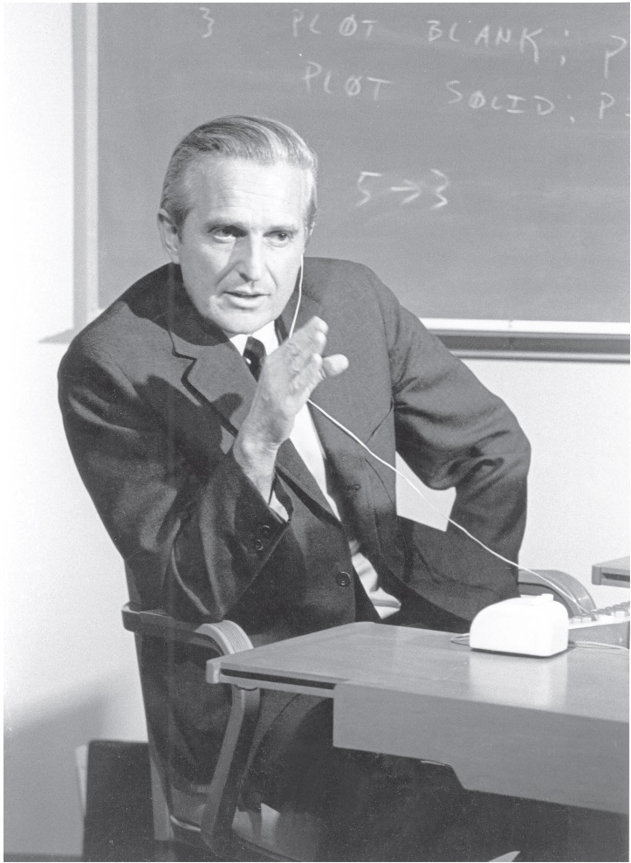
Douglas Engelbart Rehearses for “the Mother of All Demos”
Douglas Engelbart rehearses for his presentation at the 1968 Fall Joint Computer Conference. It is still called “the mother of all demos.” (P V D E/Bridgeman Images)

Slide 70
Graphical User Interface (1 of 2)
Xerox P A R C (Palo Alto Research Center)
Alan Kay saw Doug Engelbart demo in 1968
Alto personal computer (early 1970s)
Bit-mapped display, keyboard, and mouse
Apple Computer
Steve Jobs visited Xerox P A R C in 1979
Macintosh (1984)
Bit-mapped display, keyboard, and mouse

Slide 71
Graphical User Interface (2 of 2)
Microsoft Windows (1990)
Released in May 1990
Quickly became dominant graphical user interface

Slide 72
Single-Computer Hypertext Systems
Peter Brown at University of Kent
Guide (1982)
Released versions for Macintosh and I B M P C
Apple Computer
HyperCard (1987)
Hypertext system based on “stacks” of “cards”
Links represented by buttons
Basis for best-selling games Myst and Riven

Slide 73
Networked Hypertext: World Wide Web
First browser built at C E R N in Switzerland
Tim Berners-Lee: WorldWideWeb (1990)
Berners-Lee created Web protocols
Protocols based on T C P/I P → general
Mosaic, first widely used browser, developed at U. Illinois
Current favorites
Chrome
Safari
U C
Firefox
Opera
Internet Explorer

Slide 74
Search Engines (1 of 2)
Search engine
Accepts list of keywords from user
Searches a database of documents
Returns documents most closely matching keywords
Today, “search engine” usually refers to programs that search databases of Web pages

Slide 75
Search Engines (2 of 2)
Google’s search engine indexes hundreds of billions of Web pages
Google’s Book Search allows searches of full text of millions of books
PageRank
Key to high precision of Google search engine
Measures importance, quality of web page by number and quality of pages that link to it

Slide 76
Cloud Storage
Cloud storage: Storing data remotely on Internet-accessible servers
Examples of cloud storage services: Dropbox, Box, Google Drive, iCloud from Apple, Amazon Drive, Mega, pCloud
Simplifies accessing files from multiple devices
Simplifies file sharing
Provides massive data storage at a relatively low price
Provides automatic backups of data

Slide 77
1.5 Information Technology Issues

Slide 78
Information Technology
Definition of information technology:
Devices used in creation, storage, manipulation, exchange, and dissemination of data, including text, sound, and images
Examples
Tablets, smartphones, laptop computers
People making greater use of I T
Costs keep falling
Capabilities keep rising

Slide 79
I T Issues (1 of 4)
Pirating copyrighted content
Digitization → perfect copies of content
Internet → fast, inexpensive distribution
Result: illegal downloading
1st episode of season 5 of Game of Thrones illegally downloaded more than 1 million times in U.S.
Three-quarters of Chinese users of Microsoft products do not have properly licensed software

Slide 80
I T Issues (2 of 4)
Cloud storage services
Convenient to store all kinds of data, access from multiple devices, and share with others
Will data be safely stored and secure from hackers?
Credit cards
Convenience over cash and checks
Increases possibility of identity theft
Who owns information about transactions?

Slide 81
I T Issues (3 of 4)
Loan applications
Based on credit history, not personal interview
Lower interest rates, but less flexibility
Computers in embedded devices
When systems fail and harm humans, who should be liable?
Telecommuting
Saves time, allows more flexible work hours
Do teleworkers get overlooked for promotions?

Slide 82
I T Issues (4 of 4)
Improved global communication network
Allows companies to sell to entire world
Allows companies to move jobs out of U.S.
Should I T consumers be concerned about working conditions in factories in developing countries?
Social media
A conduit for democratic ideas?
Another tool for totalitarian governments?

Slide 83
Summary (1 of 2)
We are living in Information Age, but information technology has a long history
Today’s devices are culmination of centuries of incremental progress
Social conditions give rise to new technologies
Adoption of technologies can change society
Computing professionals have a responsibility to be thoughtful about their role in creating the future

Slide 84
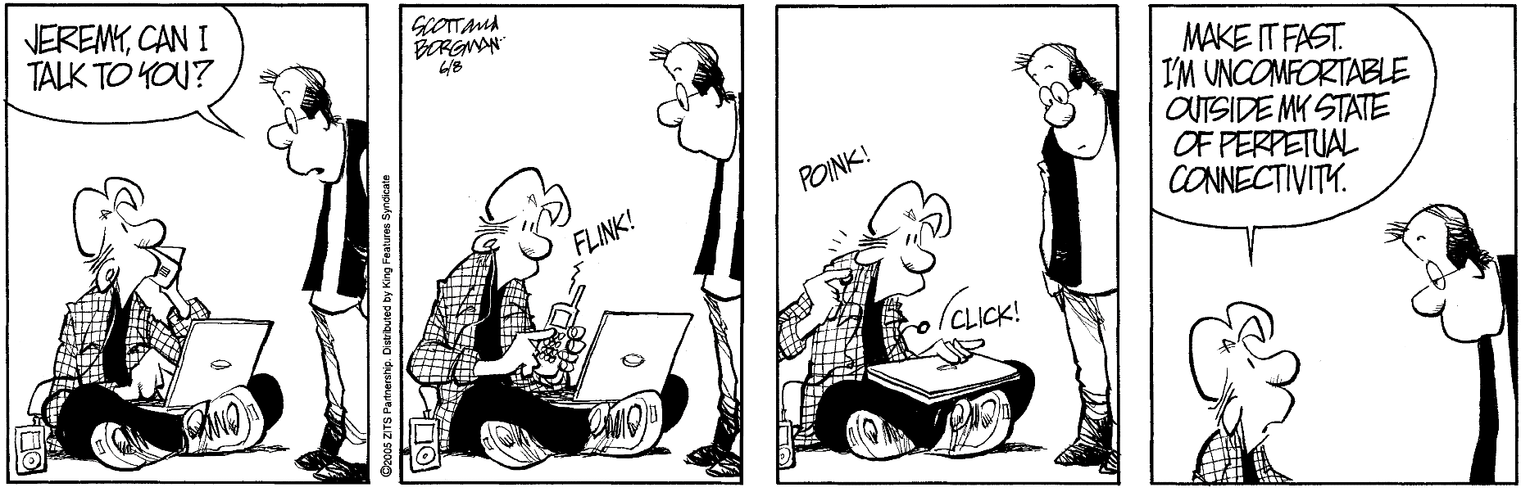
Summary (2 of 2)
© Zits Partnership. King Features Syndicate

Slide 85

Copyright
This work is protected by United States copyright laws and is provided solely for the use of instructors in teaching their courses and assessing student learning. Dissemination or sale of any part of this work (including on the World Wide Web) will destroy the integrity of the work and is not permitted. The work and materials from it should never be made available to students except by instructors using the accompanying text in their classes. All recipients of this work are expected to abide by these restrictions and to honor the intended pedagogical purposes and the needs of other instructors who rely on these materials.

